Slide 1
AgroCare: Plant Disease Detection & Crop Recommendation System
Under the Guidance
of
Prof. (Dr.) S. S. Thakur
Professor, Dept. of CSE
Presented by:
Upayan Chakraborty (11600222134)
Prerana Maiti (11600222070)
Mrigangana Sarkar (11600222062)
Sandipan Rakshit (11600222092)
Souvik Ghosh (11600222117)

Slide 2
Acknowledgement
We sincerely thank everyone who contributed to our ongoing project, "AgroCare: Plant disease detection & Crop Recommendation System".
Our deepest gratitude goes to our guide, Prof. Dr. S. S. Thakur, for his invaluable guidance and support. We also extend heartfelt thanks to Mr. Avijit Bose and Mr. Sumit Majumdar for their continuous support and facilitating our research.
We are grateful to all faculty members of the CSE Department at MCKV Institute of Engineering for their assistance and resources.
We are greatly indebted to Mr. Arijit Sen and Mr. Ajoy Ghoshal for his guidance and assistance in the hardware section of our project.
We are grateful to our peers for their feedback and collaboration.
Finally, we deeply appreciate the unwavering support, patience, and motivation from our friends and families.

Slide 3
Contents
Introduction
Crop Recommendation System Workflow
OpenWeatherMap API Integration
Chatbot Workflow
PCB Design
Circuit Diagram
Hardware Integration
Software Output
Chatbot Output
Hardware Output

Slide 4


Introduction
AgroCare Project Overview
CROP
RECOMMENDATION
CHATBOT
HARDWARE SYSTEM
Gemini API integrated
Able to answer any user query regarding plant disease detection and crop recommendation
ML Algorithm
Inputs: N, P, K, pH, Temp, Humidity, Rain
Manual input
Arduino Nano setup
Sensors: NPK, pH, Temperature, Moister
Manual transfer

Slide 5
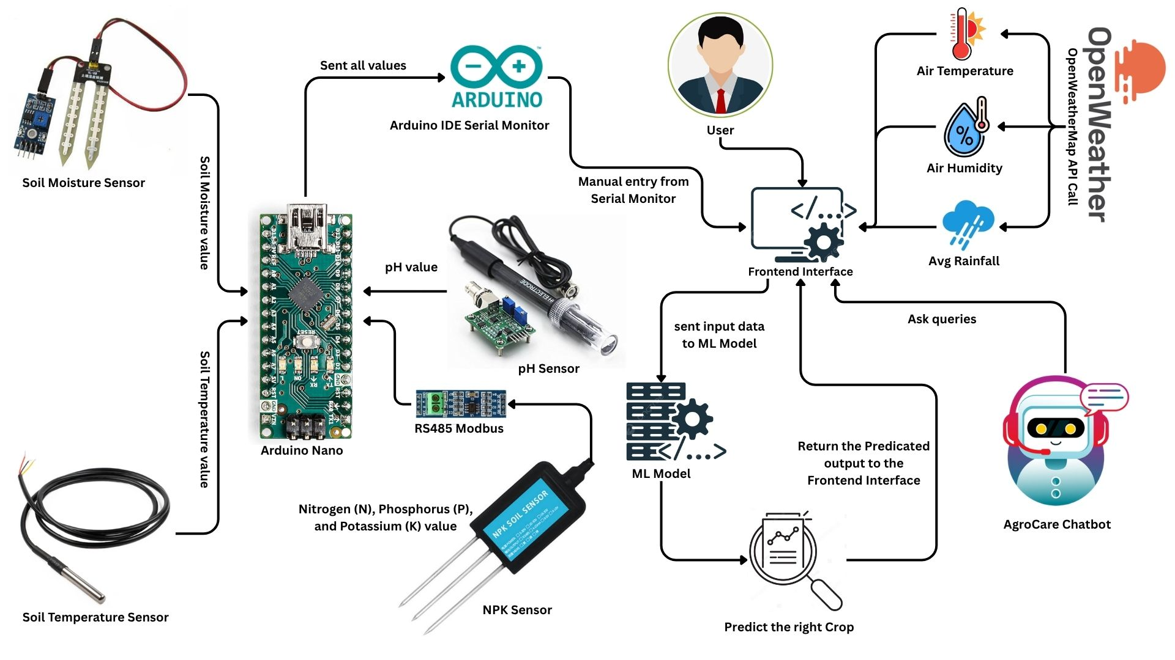
Workflow

Slide 6
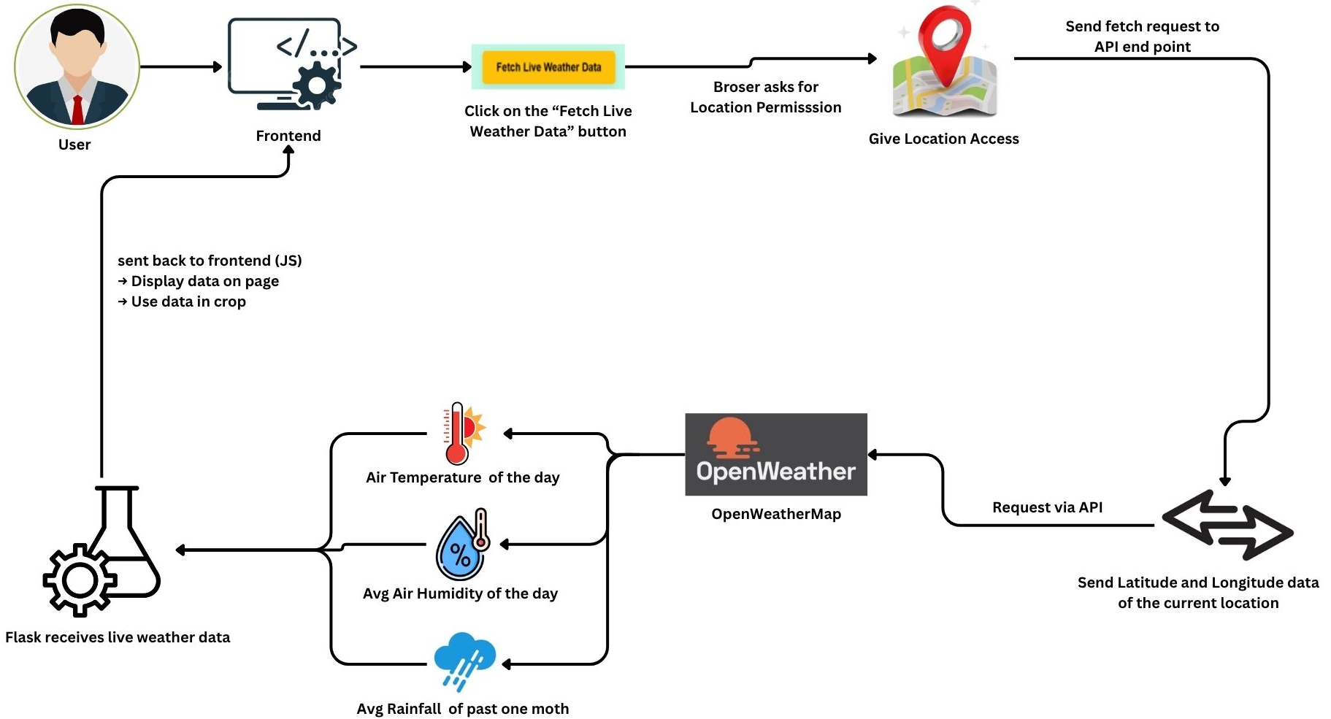
OpenWeatherMap API Integration

Slide 7
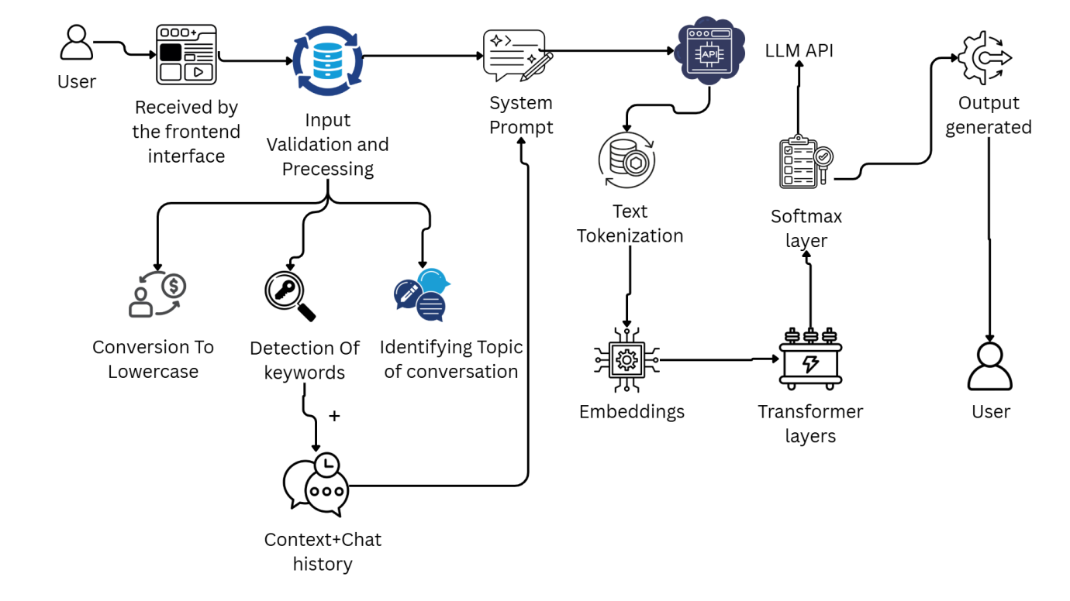
Chatbot Workflow

Slide 8
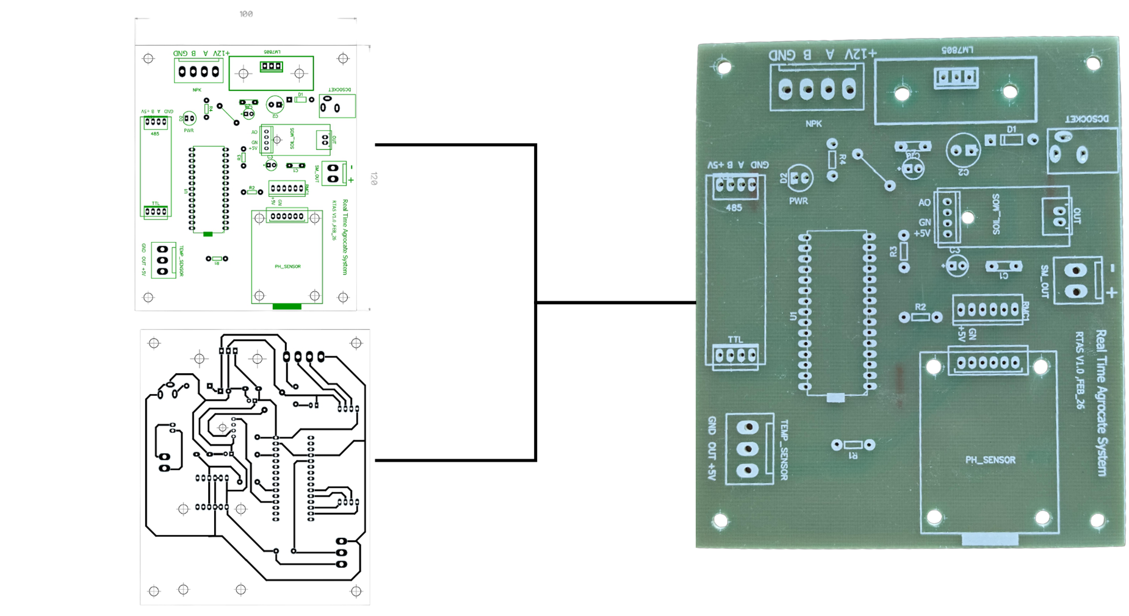
PCB Design
Front
PCB Board
Back

Slide 9
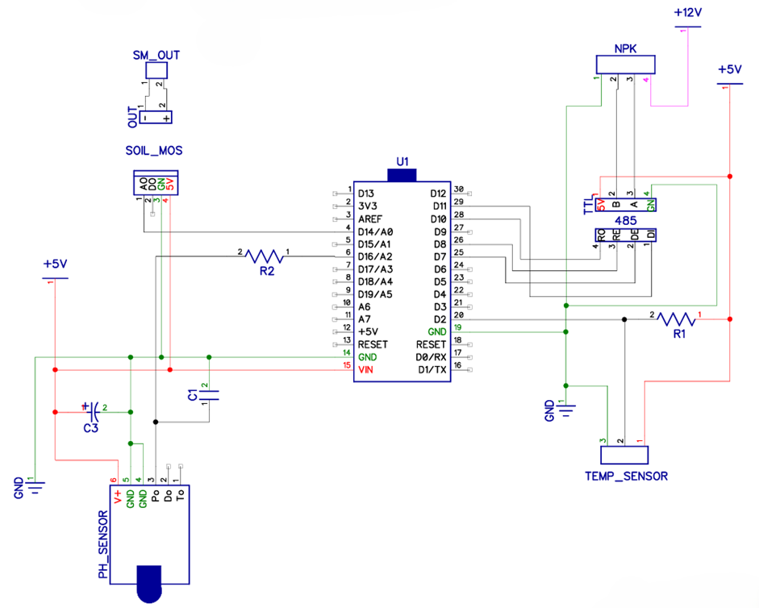
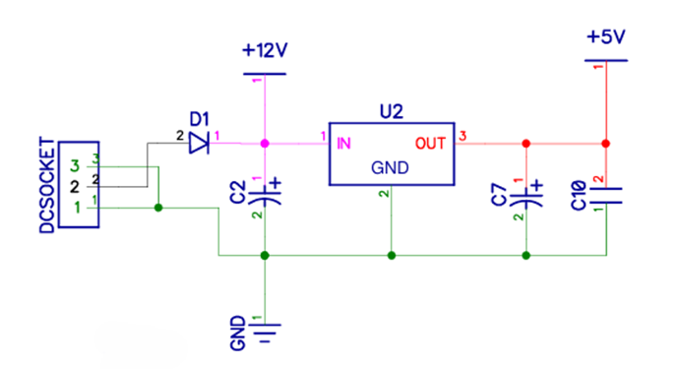
Circuit Diagram
Power Supply Diagram
Circuit Diagram

Slide 10
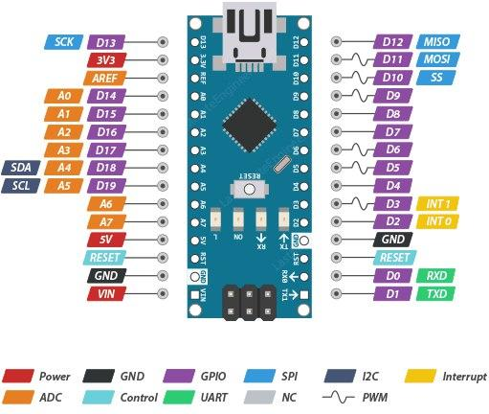
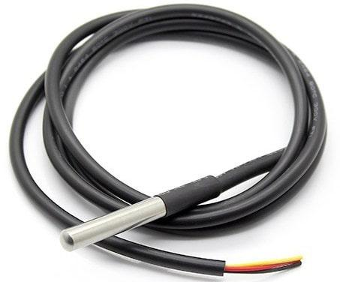
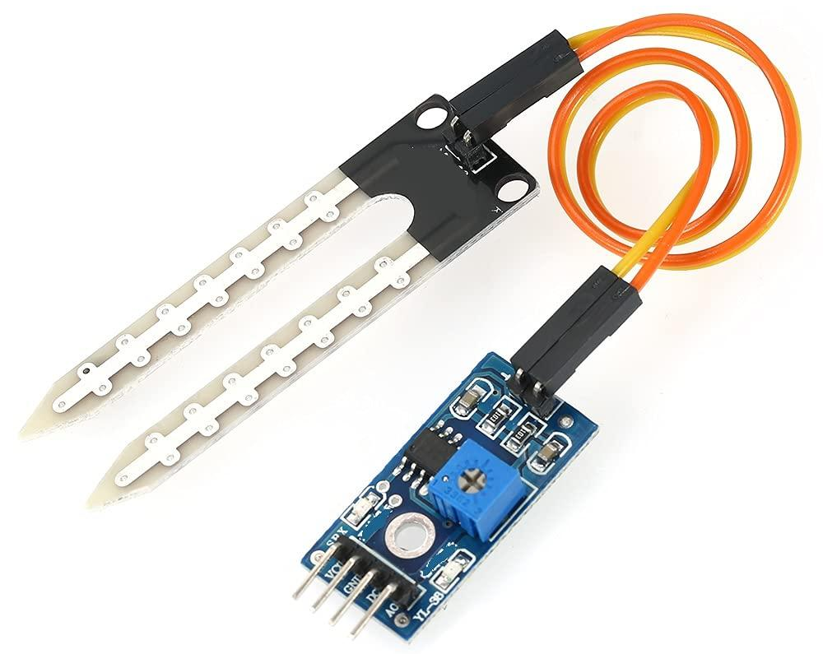
Hardware Integration
Arduino Nano
Soil Moisture Sensor
DS18B20Temperature Sensor
Based on the ATmega328P microcontroller
Provides 14 digital I/O pins and 8 analog inputs
Includes USB connectivity
Suitable for small-scale embedded and IoT projects
Measures soil water content (wet or dry)
Works by detecting changes in electrical resistance or capacitance
Ensures the optimal soil conditions for crop growth
Temperature readings from –55°C to +125°C
Uses a 1-Wire protocol by allowing multiple sensors to connect through a single data pin
Ideal for Soil temperature monitoring

Slide 11
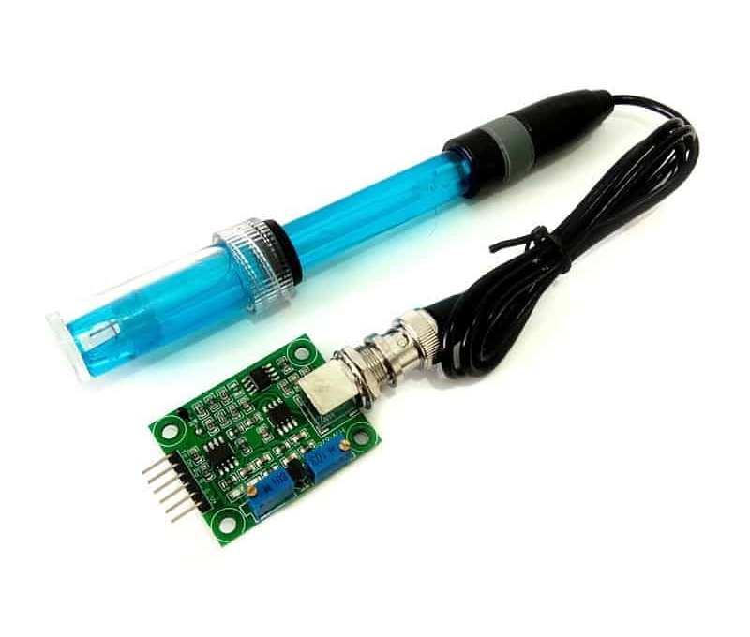
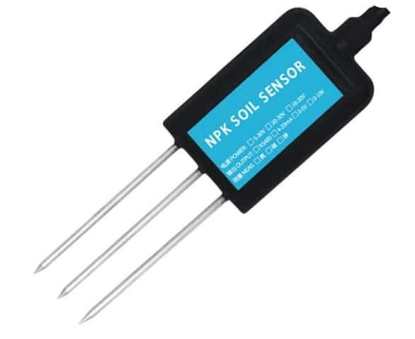
Hardware Integration
PH Sensor
NPK Sensor
Measures pH level (acidity or alkalinity) of soil or water
Provides analog or digital output for easy interfacing with microcontrollers
Comes with a probe electrode and signal conditioning module for accurate readings
Measures Nitrogen (N), Phosphorus (P), and Potassium (K) levels in soil
Uses RS485 (Modbus communication) for real-time data transmission
Features IP68 waterproof stainless steel probe for long-term soil monitoring

Slide 12
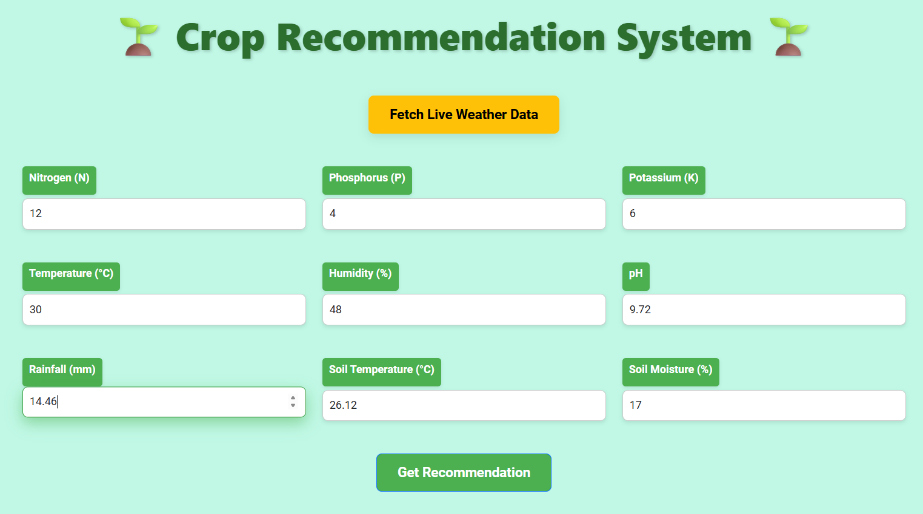
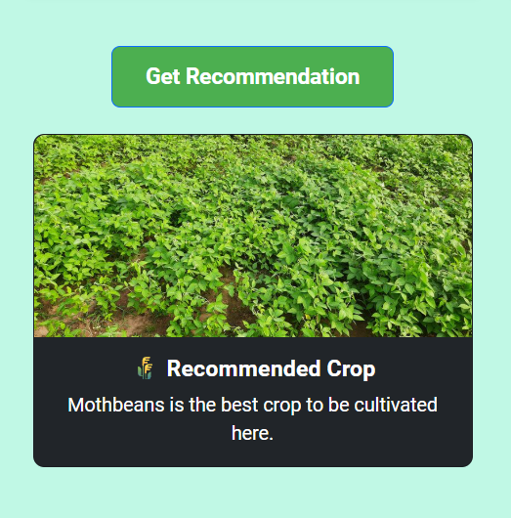
Software Output
Updated Crop Recommendation System form with sample values filled in, ready for processing and crop prediction. Live weather data fetched after clicking “Fetch Live Weather Data" button using OpenWeatherMap APIs.​
Output section of the Crop Recommendation System showing the predicted best crop (Moth beans) based on the input soil and environmental parameters.​

Slide 13
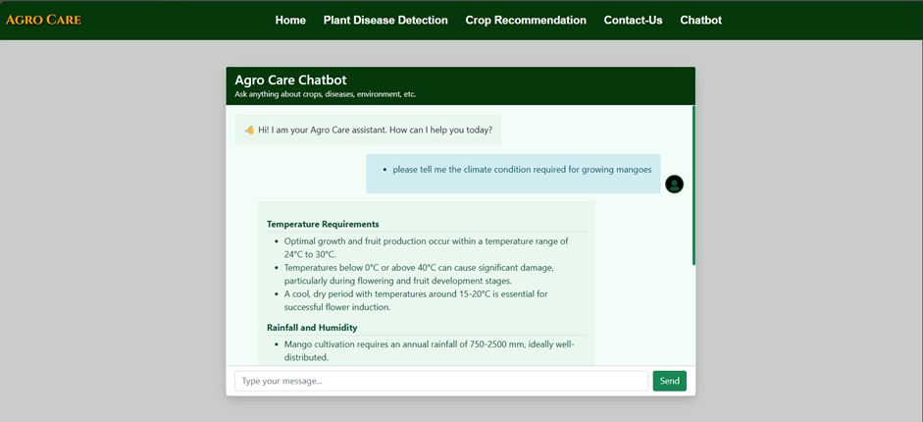
Chatbot Output

Slide 14
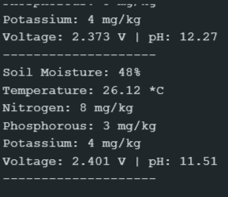
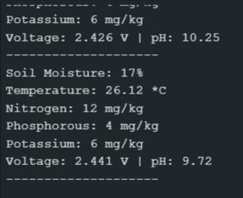
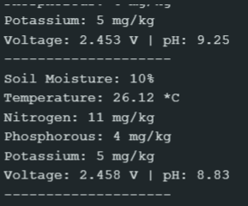
Hardware Output
A few snippets from the Serial Monitor showing the output after testing the setup on a sample soil
Variation in Soil Moisture as water is being added
Variation in Temperature as dry soil is being moisturized
Slight variations in NPK values

Slide 15
Thank You

